Slide 1









RSVP Movies Case Study
(Segment-2)

Slide 2

PROBLEM BACKGROUND
RSVP Movies is an Indian film production company which has produced many super-hit movies. They have usually released movies for the Indian audience but for their next project, they are planning to release a movie for the global audience in 2022.
The production company wants to plan their every move analytically based on data and have approached us for help with this new project. We have been provided with the data of the movies that have been released in the past three years. We have to analyze the data set and draw meaningful insights that can help them start their new project.

Slide 3
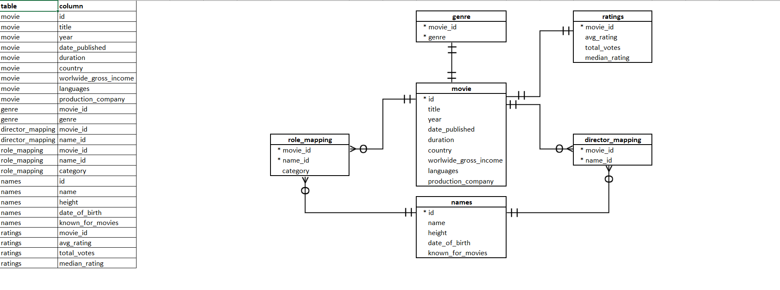
DATABASE SCHEMA

Slide 4
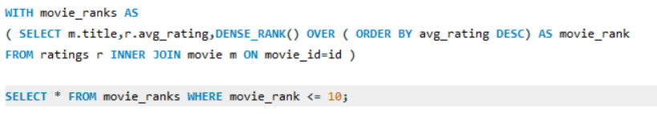
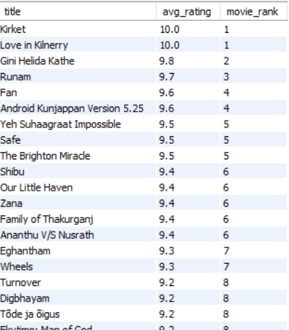
Q1.Which are the top 10 movies based on average rating?

Slide 5

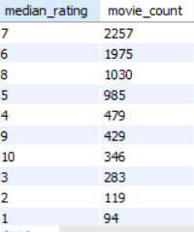
Q2. Summarise the ratings table based on the movie counts by median ratings.

Slide 6
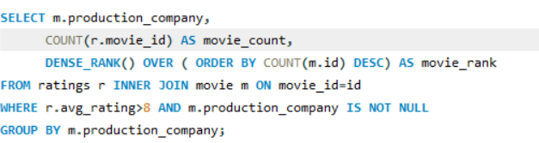
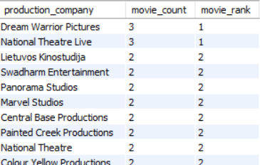
Q3. Which production house has produced the most number of hit movies (average rating > 8)?

Slide 7
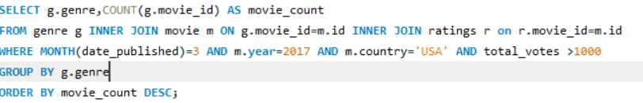
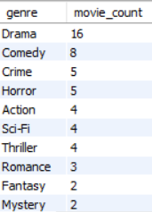
Q4. How many movies released in each genre during March 2017 in the USA had more than 1,000 votes?

Slide 8
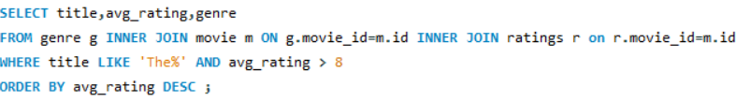
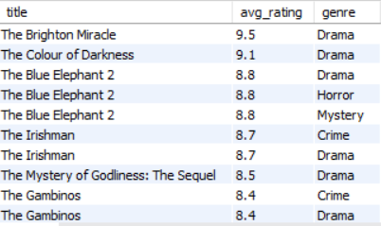
Q5.Find movies of each genre that start with the word ‘The’ and which have an average rating > 8?

Slide 9
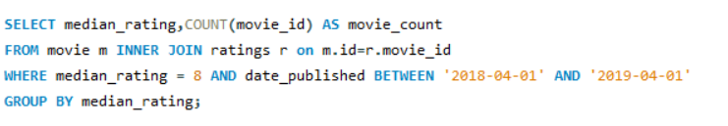

Q6. Of the movies released between 1 April 2018 and 1 April 2019, how many were given a median rating of 8?

Slide 10
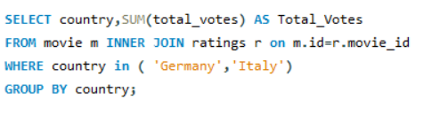

Q7.Do German movies get more votes than Italian movies?

Slide 11

SUMMARY
Indian movie FAN is in the top 10 movies with an average rating of 9.6.
Movies with a median rating of 7 is highest in number.
Dream Warrior Pictures and National Theatre Live, both the production houses have produced the most number of hit movies with average rating more than 8.
361 movies released between 1 April 2018 and 1 April 2019, with a median rating of 8.
Yes, German movies get more votes than Italian movies.

Slide 12
THANK YOU!

